Slide 1
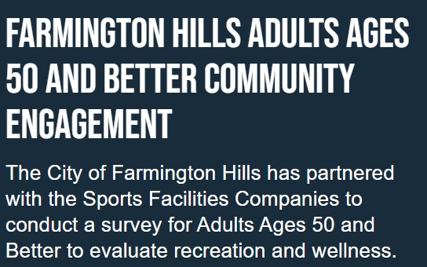
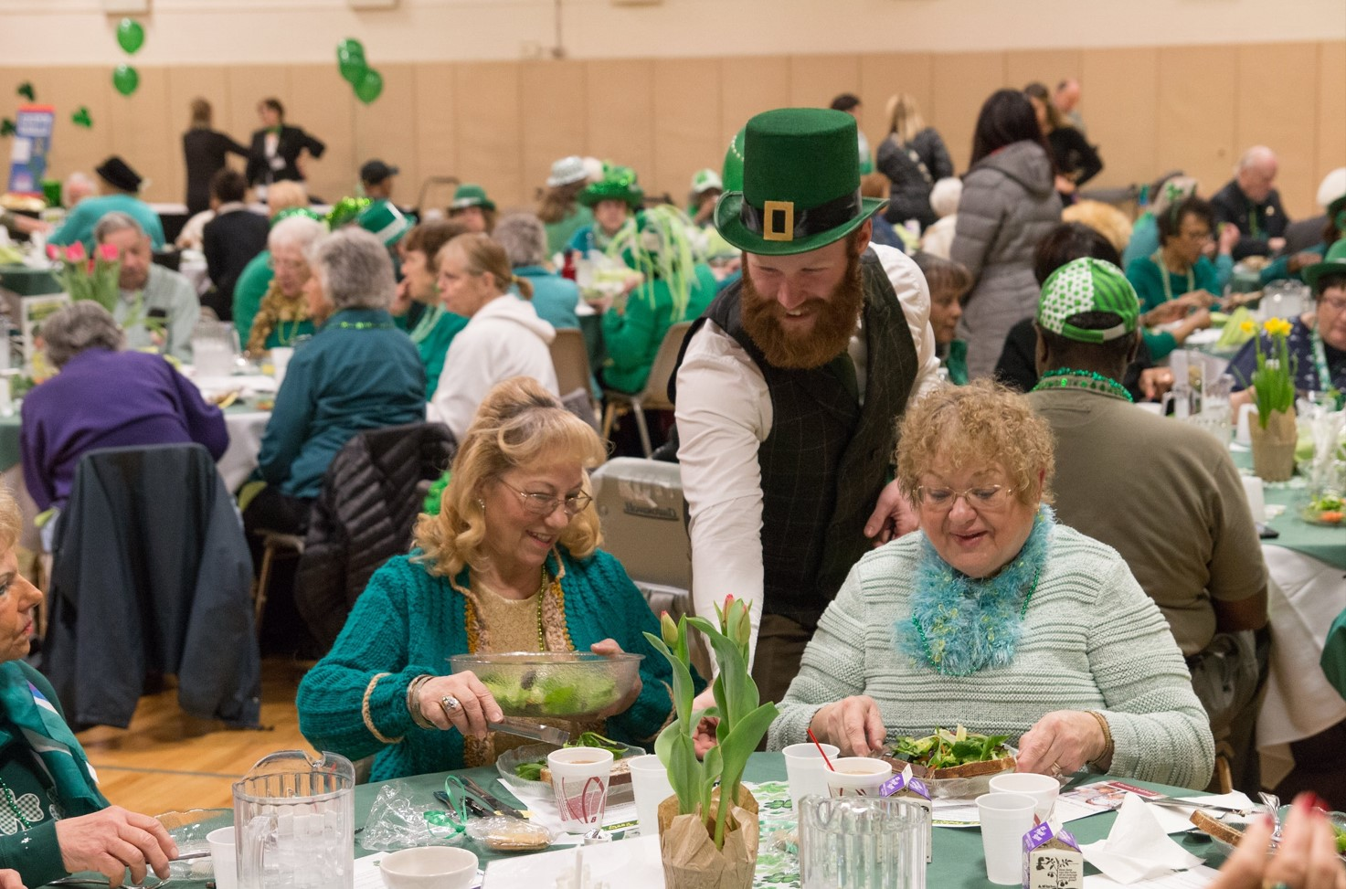
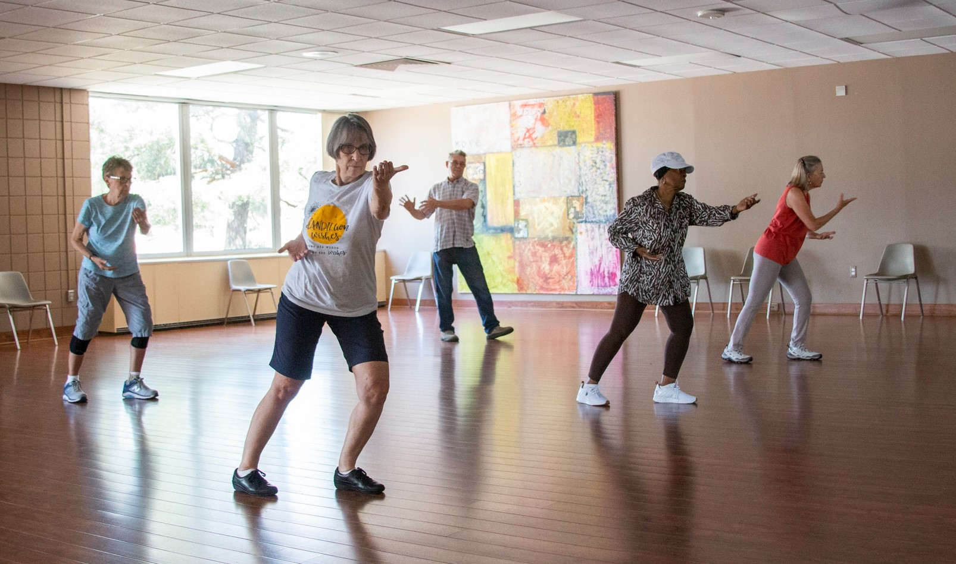
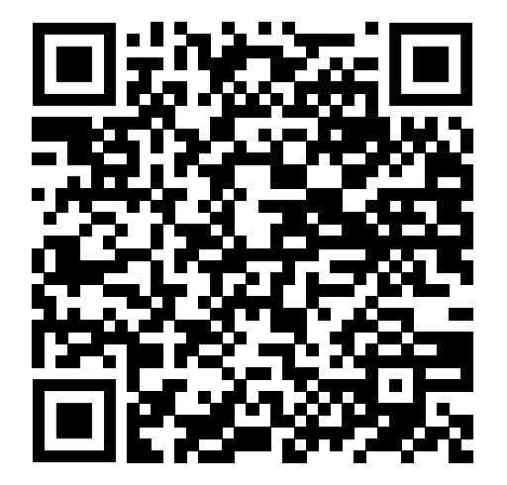
There are two methods to access the survey:
1) With your smartphone, use the QR code to the left
or
2) Copy & Paste or hand type the link below on your smartphone or computer
https://engage.sportsfacilities.com/Farmington-hills-50-and-better-community-engagement

Slide 2
1. Answer the Quick Poll Question, either Yes or No
***Click the black block named “Survey” to move to the remainder of the survey.
2. Using the drop-down menu, select your age grouping
3. Touch the appropriate circle for your frequency of visits
4. Enter how many days to expect to visit a new community center
5. In the order of importance to you, click on the various uses of the center. Click Reset to adjust
6. Using the drop-down menu, answer the Transportation question.
7. Select all choices that show what would make you more likely to visit an Adults 50 & Better facility
8. Type in any suggestions or ideas you have for a new recreation and wellness center.
*** Push the Submit button to enter your responses to the previous section.
9. Continue the survey by allotting 0 to 10 points to the activities based on their importance to you.
10. When satisfied with your choices, push the Submit button again for your completed survey
Using a Smartphone
Using a Computer
1. Answer the Quick Poll Question at the upper-right of the screen, either Yes or No
2. With drop-down menu, select your age grouping
3. Touch the appropriate circle for your frequency of visits
4. Enter how many days to expect to visit a new community center
5. In the order of importance to you, drag photos to the right. You can then drag the photos up or down to adjust the order of your choices
6. With drop-down menu, answer the Transportation question.
7. Select all choices that show what would make you more likely to visit an Adults 50 & Better facility
8. Type in any suggestions or ideas you have for a new recreation and wellness center. *** Click Submit to enter your responses to the previous section.
9. Continue the survey by allotting 0 to 10 points to the activities based on their importance to you.
10. When satisfied with your choices, push the Submit button again for your completed survey

